Slide 1
LightFM
Modern recommender engine in pythondern
Gidi Shperber – Data Scientist, freelance
Notes:
Im going to talk about a nice recommendation system library in python which is called light FM
i will try to divide this short talk, and give half of it about some theory and background, and the other half about parctical use
I also have jupyter notebook which i’ll upload later to ...

Slide 2
Recommender Systems
Netflix: ⅔ of the movies watched are recommended
Google news - recommendations generate 38% more click rate
Amazon - 35% of sales are from recommendation
Facebook ad algorithm - heavily based on recommendation engine
many other stories
Notes:
Recommednder systems,
I don't think I need to introduce, everyone knows that is it, everyone knows it’s valuable
But what do people do? What algorithms are useful? Defintely less pr then image recognition or NLP [ though it gives the most comemrcial value]

Slide 3
Recommender systems - where are we at?
The Netflix prize
2006 - improve the netflix recommender algorithm by 10% and get 1M$!
2009 - the prize was claimed
top 2 algorithms are still in production
Notes:
From historic point of view, most importent and famous case is netflix prize

Slide 4
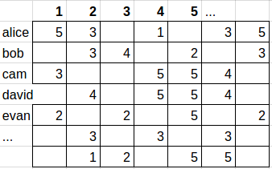
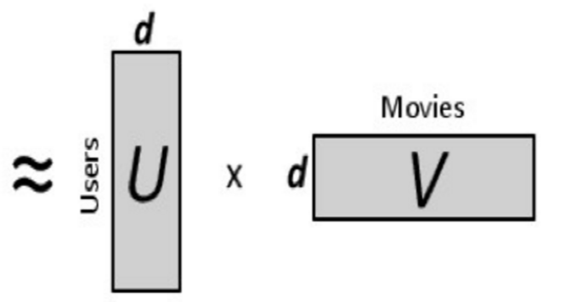
Netflix winner - Matrix factorization
user=bob
item=1
predicted score=3.5
1,2,3,4,5… - movies
Notes:
A few words about the winning algorithm:
Facotrizing user item interaction matrix in to 2 smaller ones, which allow predicitng the missing values
Meta data which was availble was not found helpful

Slide 5
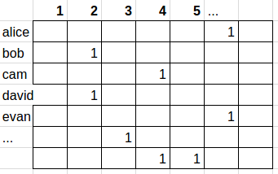
Matrix Factorization - is that it?
more issues: cold start implicit/explicit retrain with every new data point?
real world - sparsity 99.95%
movies - sparsity up to 99%
Notes:
However, real world data is not the same as the competitoin data from a few aspects, most importently, the data is much more sparse, as you can see in the illustration
Im talking especially about ecommerce, and music such as spotify.
Different approaches should be tried, especially trying to incorporate the side features into the model

Slide 6


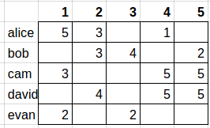
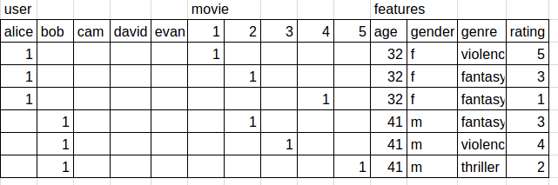
Factorization machines
http://www.csie.ntu.edu.tw/~b97053/paper/Rendle2010FM.pdf - Steffen Rendle
Notes:
In 2011 the answer came: a model which combines efficently interactions and meta data.
Applied very innovative technique.
The basic idea is tho treat the data in a different format, but there is more to it.
Read the article

Slide 7
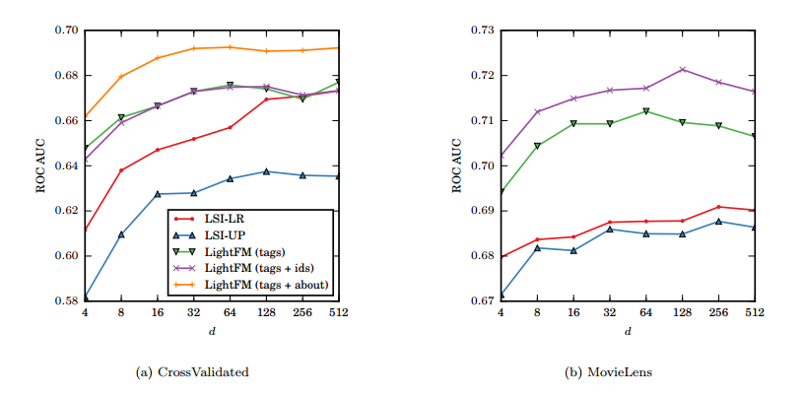
Light FM
https://github.com/lyst/lightfm, 832 stars
article - https://arxiv.org/pdf/1507.08439.pdf
Notes:
Lyst’s (fashion ecommerce) data scientist Maciej Kula brings us this great python package to allow us easily use the factorization machines with other tricks and extension in python
here you can see its results, beating all competition according the article
As with most of this things, it takes a few years before an article is ripe enough to become a well maintained package, here it happened in 2015

Slide 8
LightFM - how to use
simple:
model=LightFM(params)
model.fit(data['train'], user_features,item_features,epochs=30, num_threads=2)
model.predict(user_ids,item_ids) - predicts score
Evaluation.auc_score(model, data)
Notes:
how to use:
simple and standard
sparse data format
Fast
Fancy loss functions – Warp, BRP

Slide 9
Example - stack exchange questions
The dataset has 3,221 X 72,360 items, with 62,000 interactions interactions in the training set.
questions are tagged.
example:
What should be the value of a feature if it can contain some invalid cases? [machine learning, calssifications]
Variance Inflation Factors are incredibly high for t1 - can I use this model [time-series, multiple-regression]

Slide 10
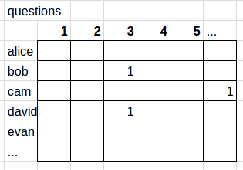
Example - stack exchange
pure matrix factorization

Slide 11
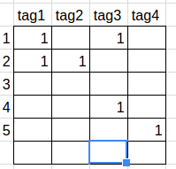
Example - stack exchange
Factorization machines model
+

Slide 12
Light FM useful links
article - https://arxiv.org/pdf/1507.08439.pdf
github - https://github.com/lyst/lightfm
doumentation - http://lyst.github.io/lightfm/docs/home.html
examples - http://lyst.github.io/lightfm/docs/examples.html

Slide 13
LightFM - more abilities
optimizing ranking:
methods: BPR, WARP
Built in model evaluation:
precision@k,auc_score
http://blog.ethanrosenthal.com/2016/11/07/implicit-mf-part-2/
Notes:
features
2 ranking methods
Tanking is also an innovation here. Instead of optimizing something like least squares, or probability using sgd or something, you pick randomly 2samples each time, check the model prediciton, and if its incorrect you update them (simplisticly)
2 evaluation metric

Slide 14



Questions?
shgidi@gmail.com
shgidi
Gidi Shperber

